Slide 1

Forecasting the Next Solar Maximum
531T – Time Series Analysis
Final Project
Judith Victoria, Aaron Jones & Greg Johnson

Slide 2
Overview
Background
The Data
Time Series Analysis
Regression Models
Holt-Winters
SARIMA
Conclusions
Questions

Slide 3

Background
What are sunspots?
The solar cycle: maximums and minimums
Our project goal: predict recent solar maximum
Notes:
Sunspots are areas of reduced surface temperature on the outer shell of the sun. They’re caused by a magnetic field flux – basically the magnetic field of the sun passing through its surface (?)
Sunspot activity occurs in periods of, on average, eleven years (since 1755, they have ranged from 9 to 13.7). The point of highest sunspot activity is the solar maximum; lowest is the solar minimum. A solar cycle starts and ends on the solar minimum.
The most recent solar cycle started in January 2008 and is ongoing however the solar maximum has already occurred in April 2014. Our project goal is to predict this recent solar maximum using the analyses we’ve learned in this class.

Slide 4
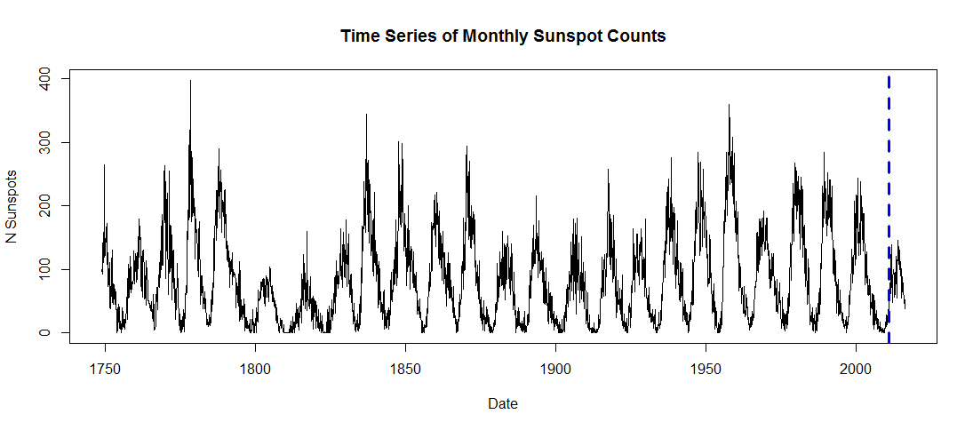
The Data
Monthly data (1/1749-present) is from SILSO
Collected by visual observation
Segmented into:
Train: 1/1749-12/2010 (3144 data points)
Test: 1/2011-present (65 data points)

Slide 5
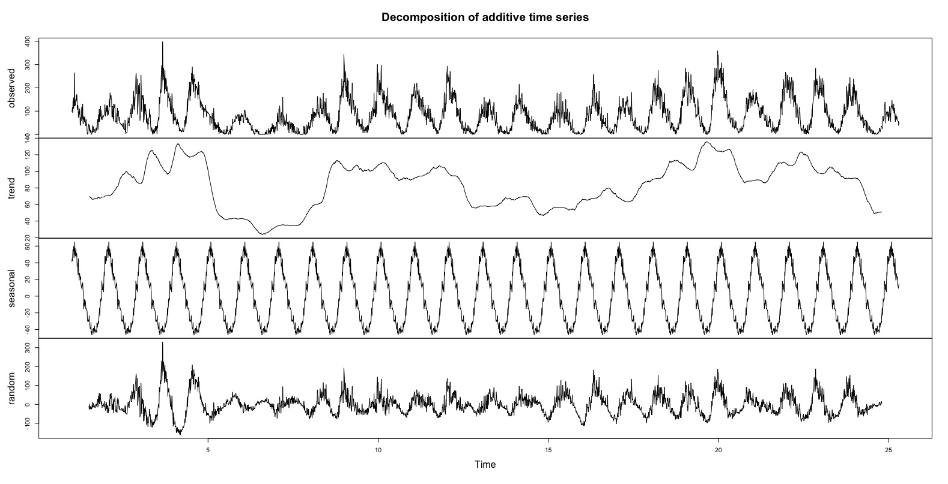
The Data: Decomposition

Slide 6
Regression

Slide 7
Possible Models
Full Model all data
Quadratic and Season Trend all data
Quadratic and Season Trend on 12 season
Log Transformation on12 season
Season Trend on 12 season

Slide 8
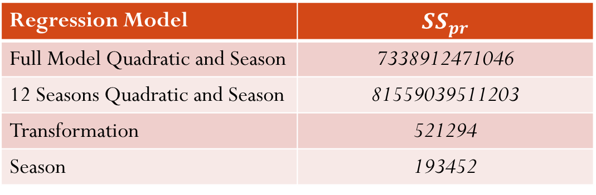
SSPr of Models
Regression Model | $$SS_{pr}$$
Full Model Quadratic and Season | 7338912471046
12 Seasons Quadratic and Season | 81559039511203
Transformation | 521294
Season | 193452

Slide 9
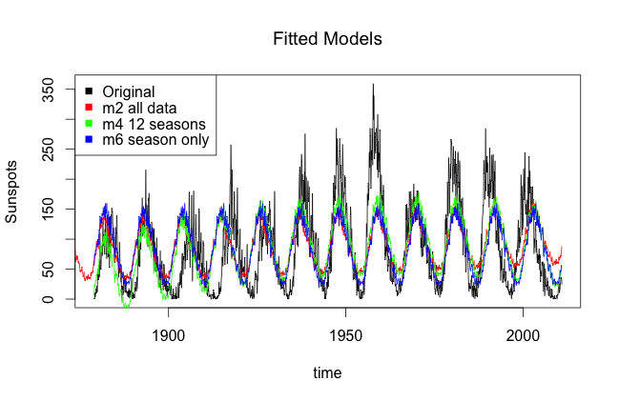
Analyses: Regression

Slide 10
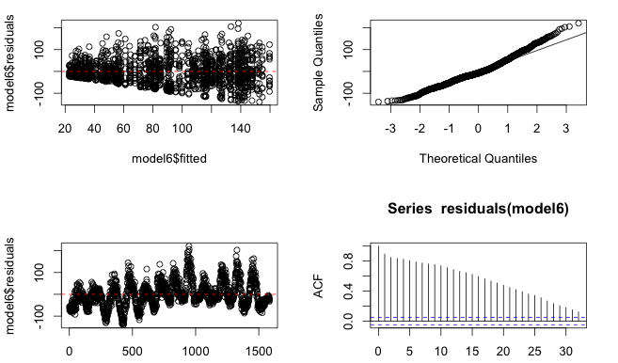
Residual Diagnostics

Slide 11
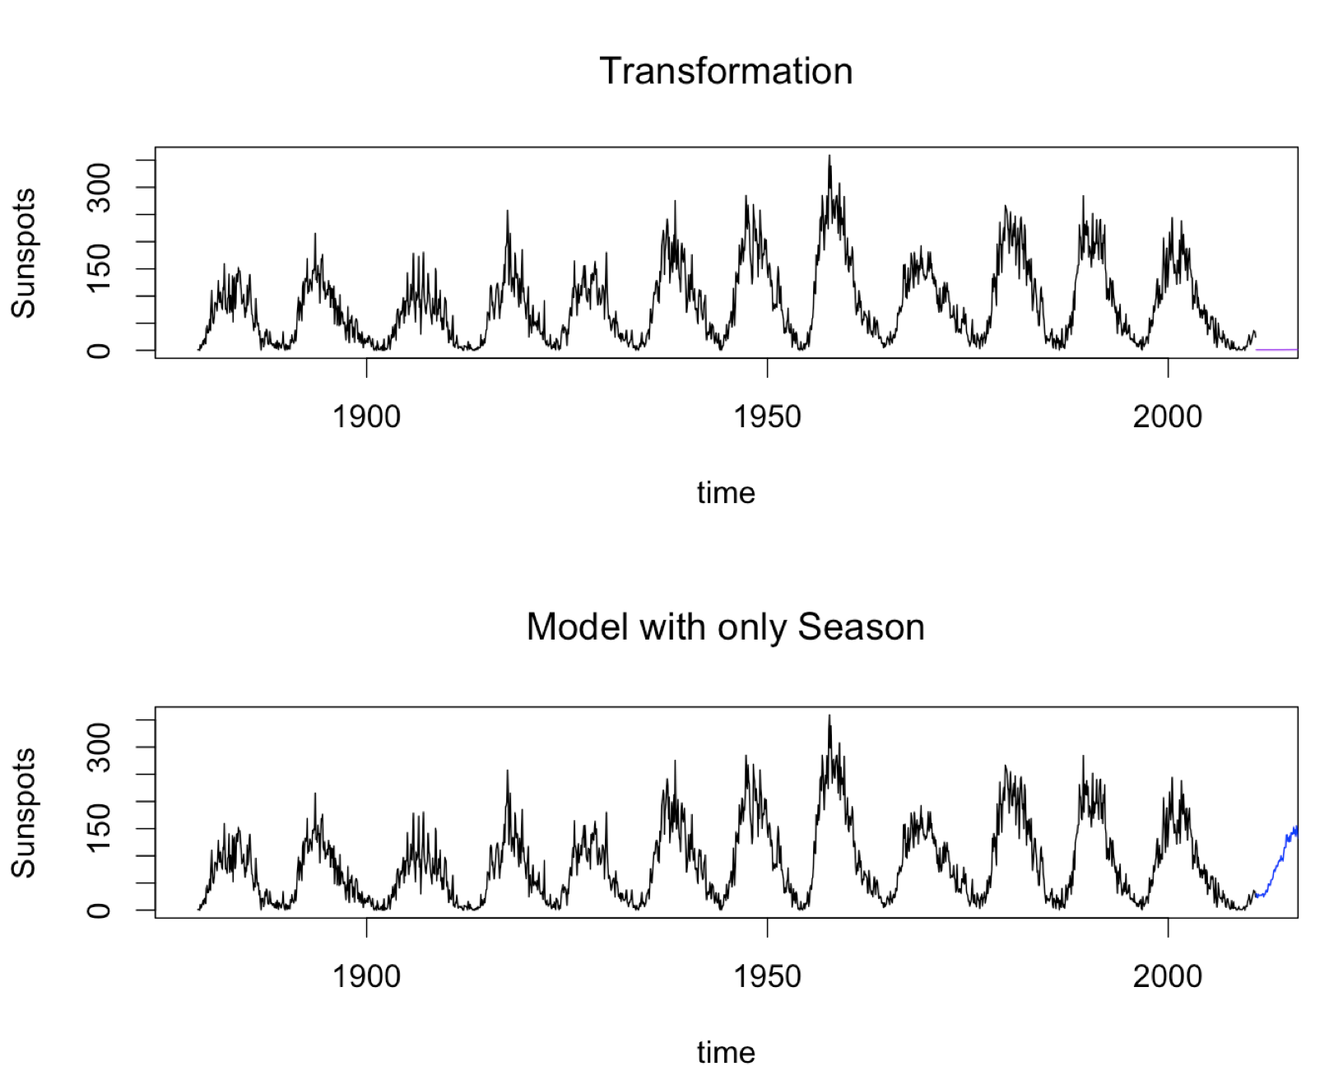
Prediction Plots

Slide 12
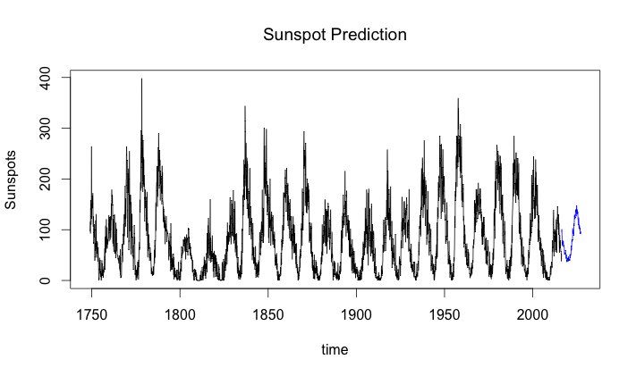
Predicting on Full data
Max: 147.412
Dec 2014

Slide 13
Holt-Winters

Slide 14
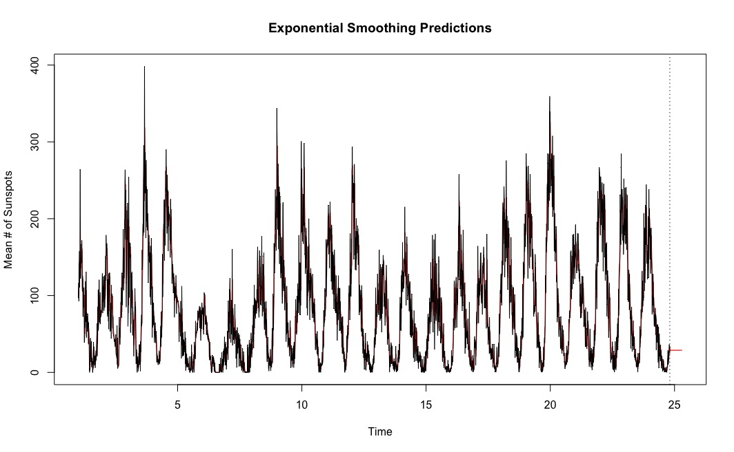
Exponential
Full Training Data
SS_{pr}=255,537.23
Residuals Violate Assumptions

Slide 15
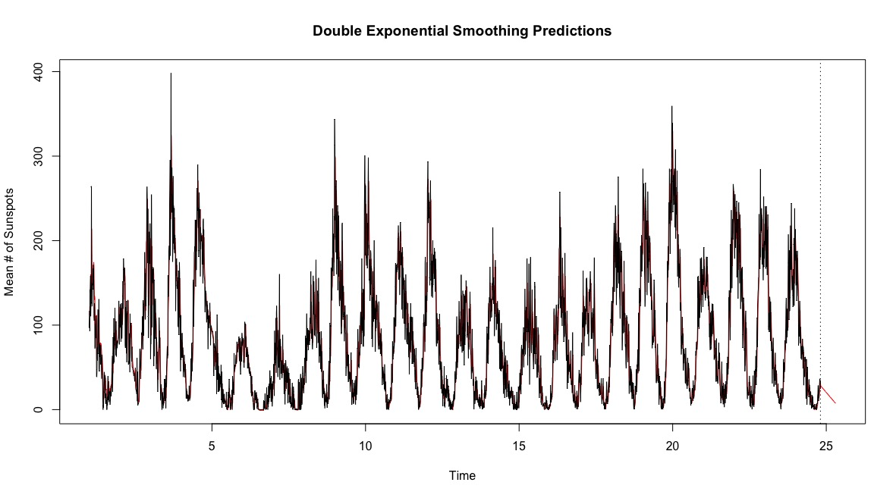
Double Exponential
Full Training Data
SS_{pr}=345,068.31
Residuals Violate Assumptions

Slide 16
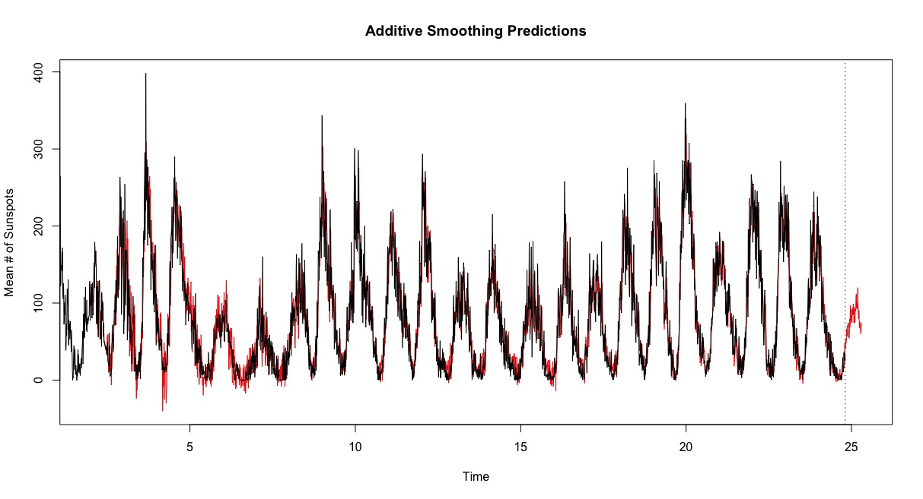
Additive
Full Training Data
SS_{pr}=45,444.55
Residuals Violate Assumptions

Slide 17
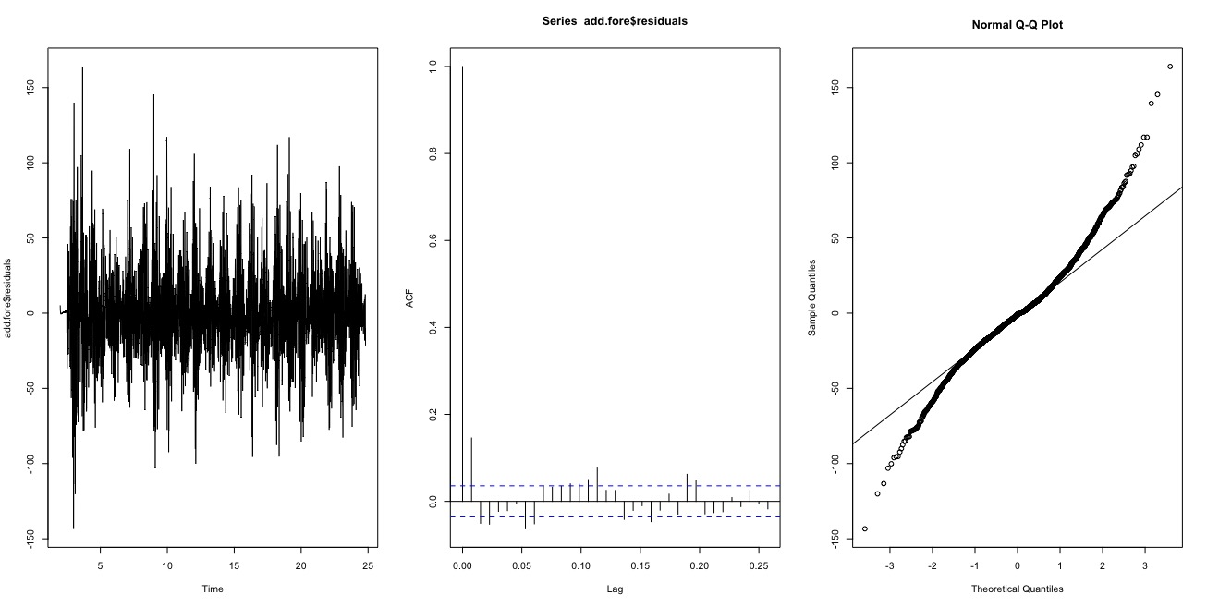
Residual Diagnostics

Slide 18
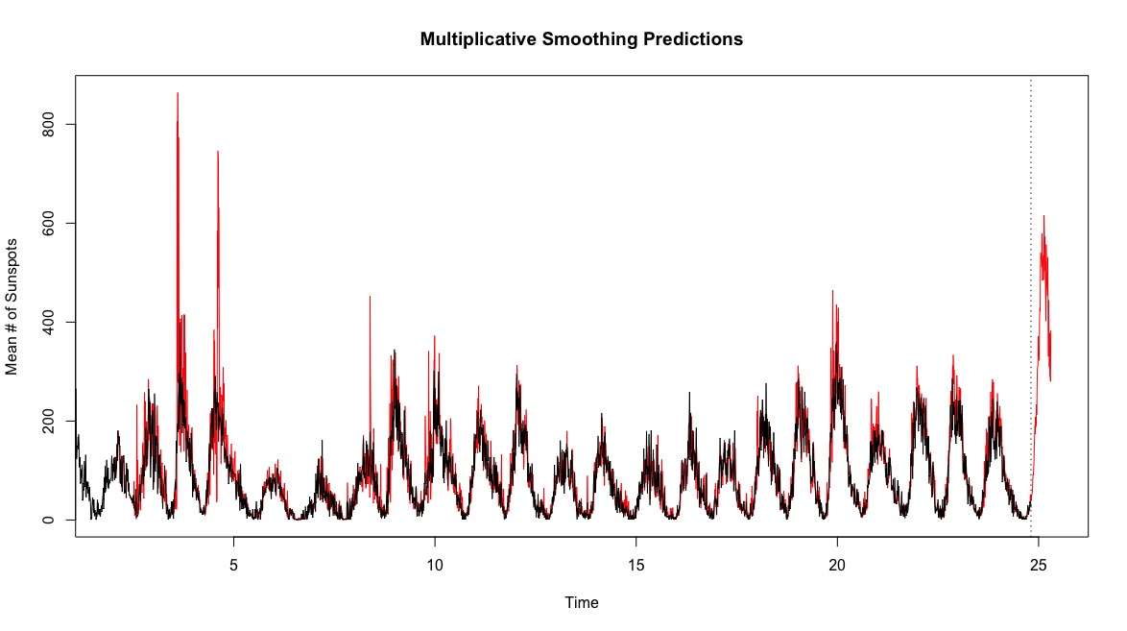
Multiplicative
Full Training Data
SS_{pr}=6,205,203.67
Residuals Violate Assumptions

Slide 19
SS_{pr}
Model | Sum of Squares Predicted
Exponential | 255537.228
Double Exponential | 345068.3116
Additive | 45444.54925
Multiplicative | 6205203.668
Exponential - 12 Seasons | 256372.3483
Double Exponential - 12 Seasons | 240727.4386
Additive - 12 Seasons | 176423.8714
Multiplicative - 12 Seasons | 492631.6519

Slide 20
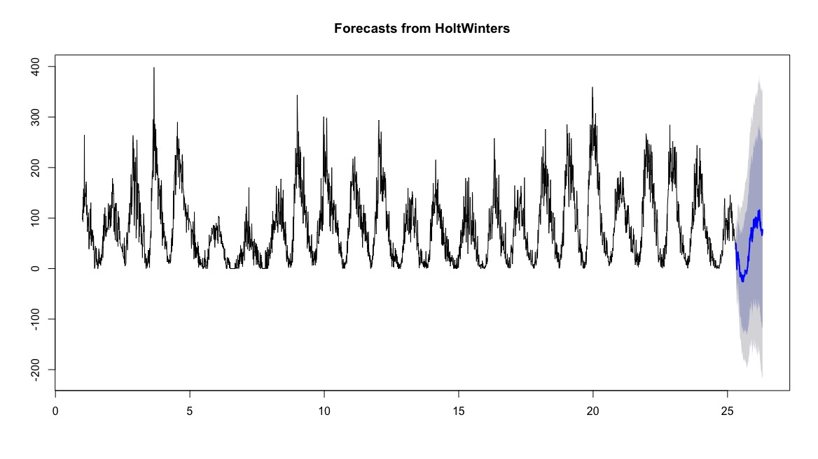
Forecast

Slide 21
Box Jenkins

Slide 22
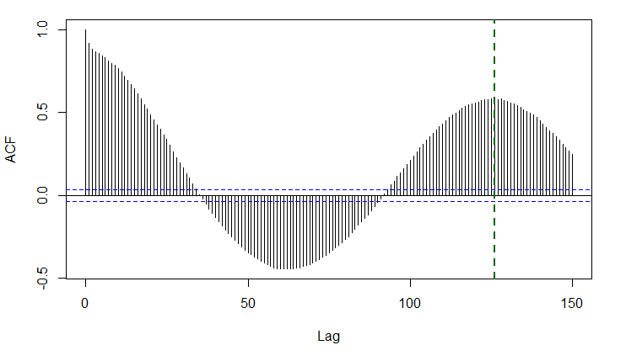

Establishing Stationarity
Data is non-stationary – seasonal with period of 11 years (132 months)
$S=132$ in our SARIMA model and $D≥1$

Slide 23
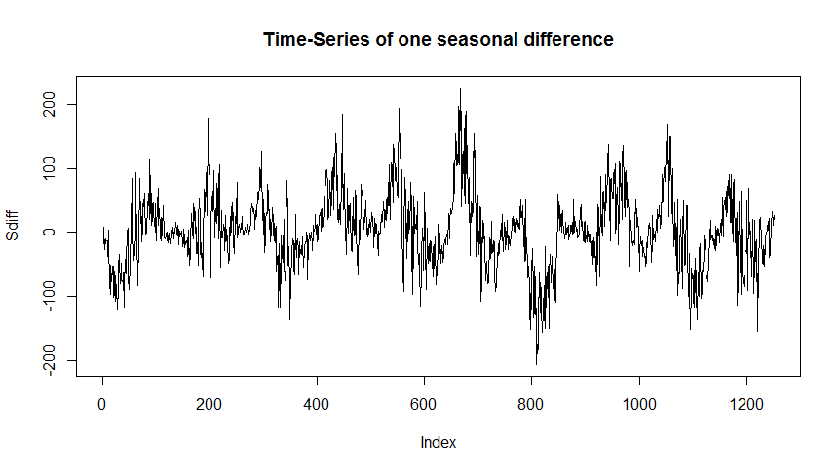
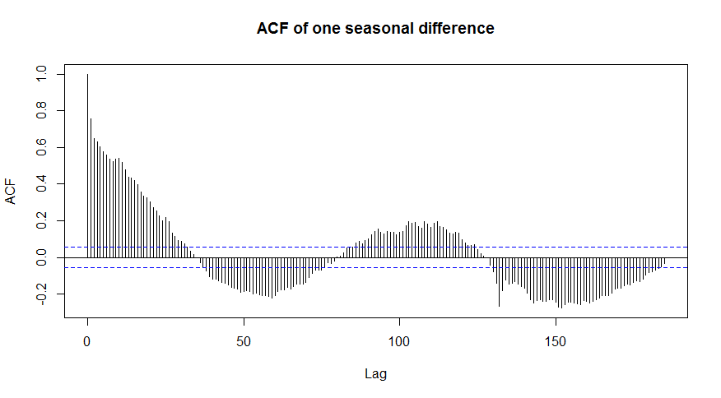
Further Differencing?

Slide 24
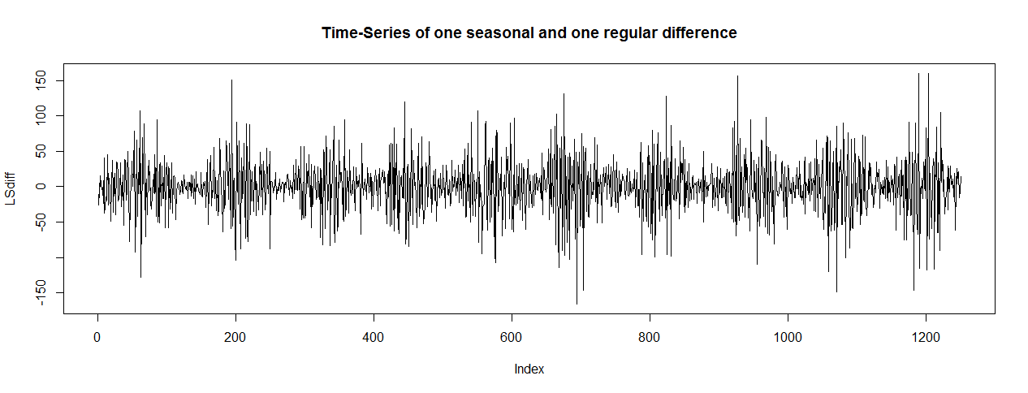
More differencing
Further seasonal differencing doesn’t work. First-order differencing does:

Slide 25
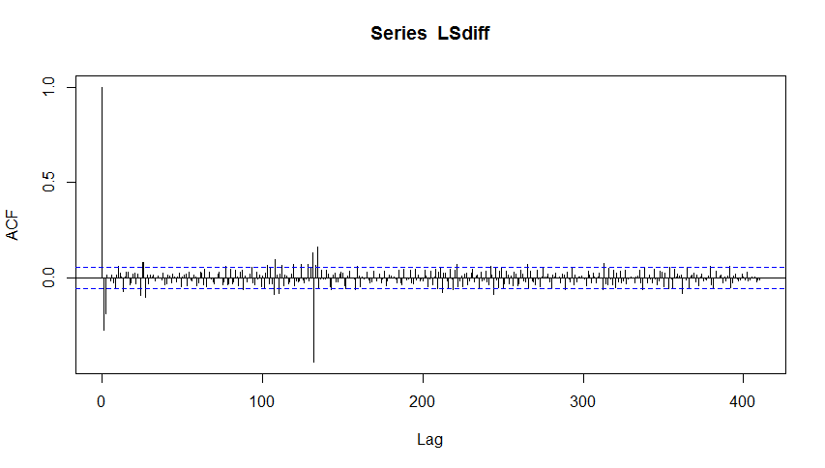
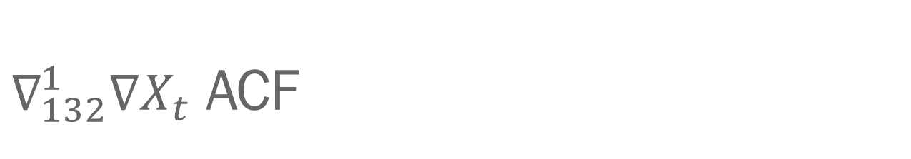
$∇_{132}^{1}∇X_{t}$ ACF

Slide 26
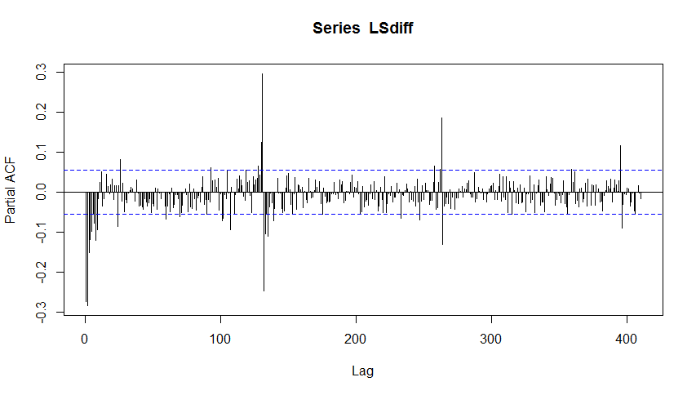
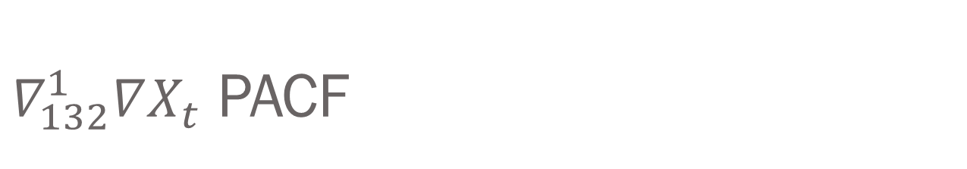
$∇_{132}^{1}∇X_{t}$ PACF

Slide 27
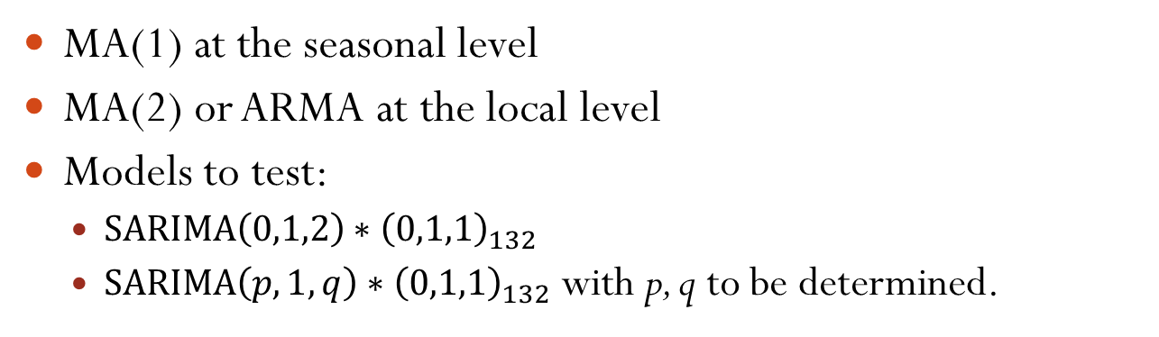
Proposing Models
 | ACF | PACF
Local | Lag 1 or Exponential Decay | Sinusoidal Decay
Seasonal | Lag 1 | Exponential Decay
MA(1) at the seasonal level
MA(2) or ARMA at the local level
Models to test:
$SARIMA\left(0,1,2\right)∗{\left(0,1,1\right)}_{132}$
$SARIMA\left(p,1,q\right)∗{\left(0,1,1\right)}_{132}$ with p, q to be determined.

Slide 28
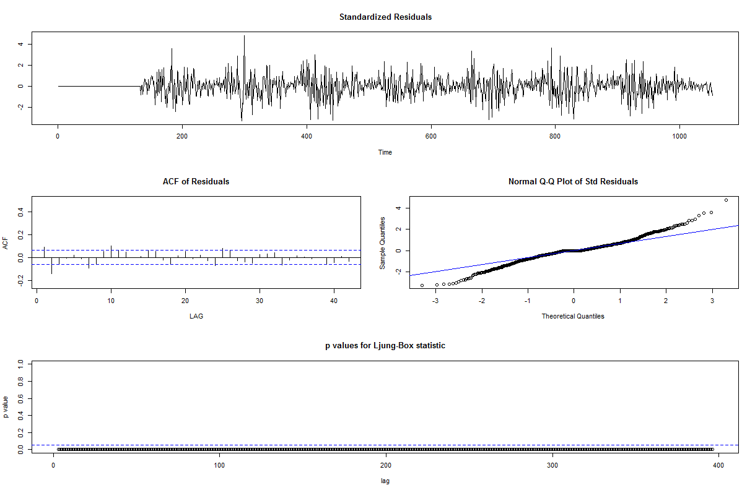
Residual Diagnostics

Slide 29
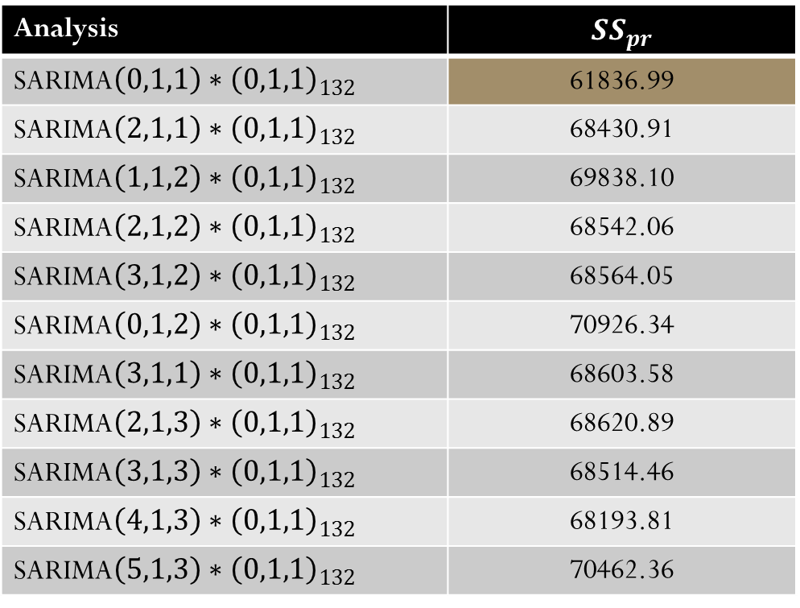
Comparing Models
Analysis | $$SS_{pr}$$
SARIMA$\left(0,1,1\right)∗{\left(0,1,1\right)}_{132}$ | 61836.99
SARIMA$\left(2,1,1\right)∗{\left(0,1,1\right)}_{132}$ | 68430.91
SARIMA$\left(1,1,2\right)∗{\left(0,1,1\right)}_{132}$ | 69838.10
SARIMA$\left(2,1,2\right)∗{\left(0,1,1\right)}_{132}$ | 68542.06
SARIMA$\left(3,1,2\right)∗{\left(0,1,1\right)}_{132}$ | 68564.05
SARIMA$\left(0,1,2\right)∗{\left(0,1,1\right)}_{132}$ | 70926.34
SARIMA$\left(3,1,1\right)∗{\left(0,1,1\right)}_{132}$ | 68603.58
SARIMA$\left(2,1,3\right)∗{\left(0,1,1\right)}_{132}$ | 68620.89
SARIMA$\left(3,1,3\right)∗{\left(0,1,1\right)}_{132}$ | 68514.46
SARIMA$\left(4,1,3\right)∗{\left(0,1,1\right)}_{132}$ | 68193.81
SARIMA$\left(5,1,3\right)∗{\left(0,1,1\right)}_{132}$ | 70462.36

Slide 30
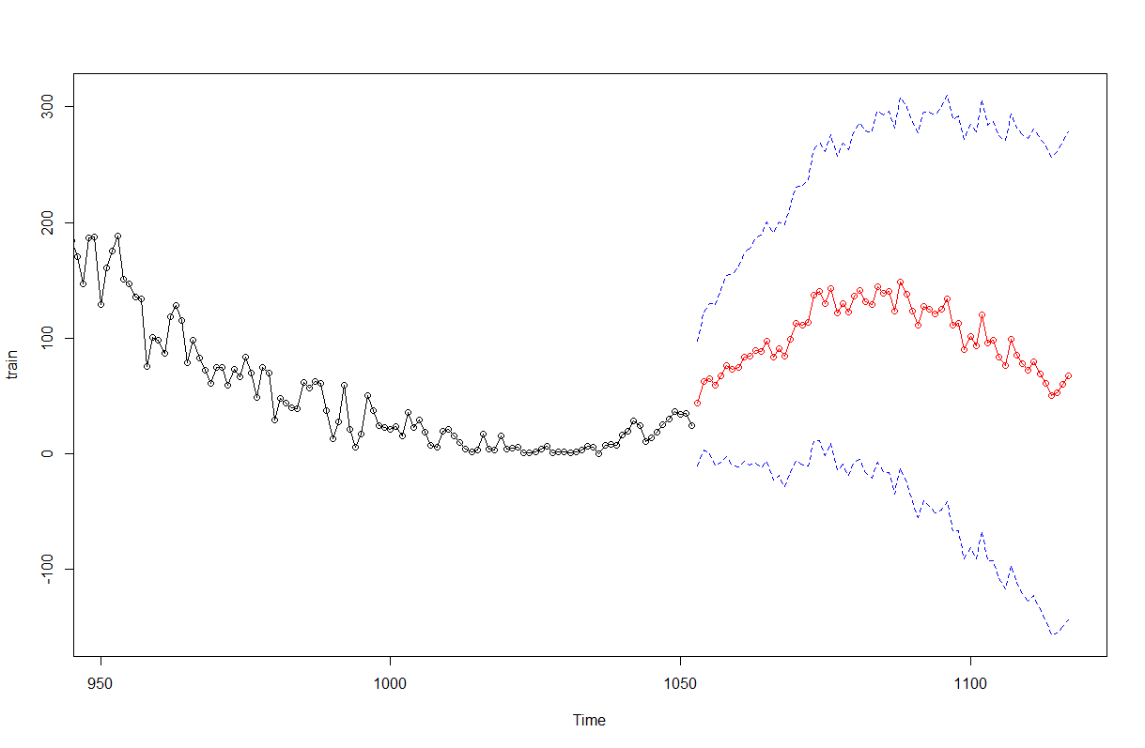
Forecasting with best model

Slide 31
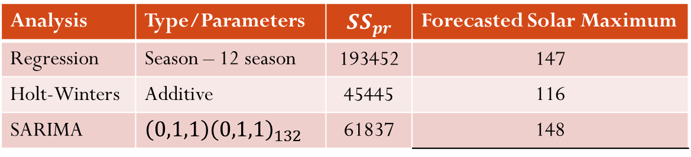
Conclusion: Comparing Methods
Comparing the best model of each of the three methods.
Analysis | Type/Parameters | $$SS_{pr}$$ | Forecasted Solar Maximum
Regression | Season – 12 season | 193452 | 147
Holt-Winters | Additive | 45445 | 116
SARIMA | $$\left(0,1,1\right){\left(0,1,1\right)}_{132}$$ | 61837 | 148

Slide 32
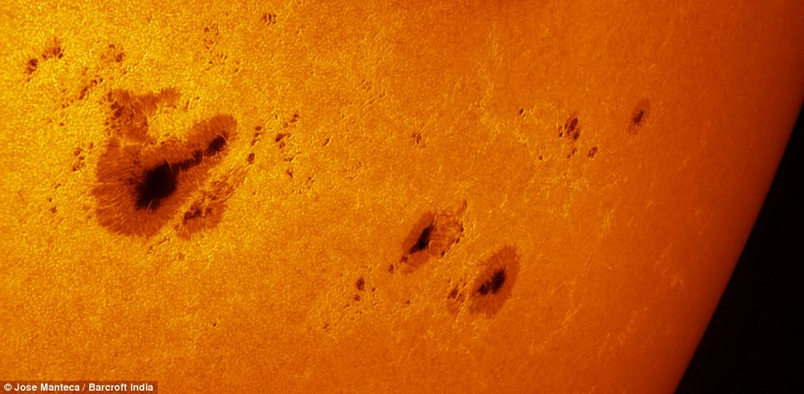
Questions?

